Slide 1


Blog post Classification using Natural Language Processing
Rahul Gera
Babandeep Singh
Robin Beura

Slide 2
Introduction
The number of blog posts is increasing exponentially.
Technorati’s web crawlers indicate that there are about 12,000 new blogs created each day; put another way, a new weblog is created every 7.4 seconds.
We devised a content classification system to automatically suggest the blogs to the right audience in terms of age group.
It is difficult to group text into categories because of freestyle natural language.
Bloggers at different levels write whatever is appealing to their mind, thus inventing sometimes new vocabulary and grammar..

Slide 3
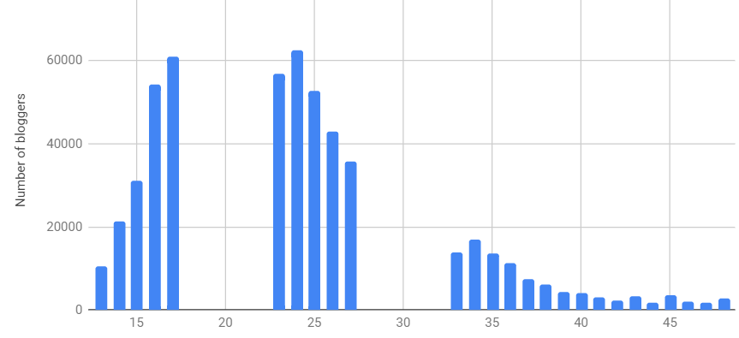
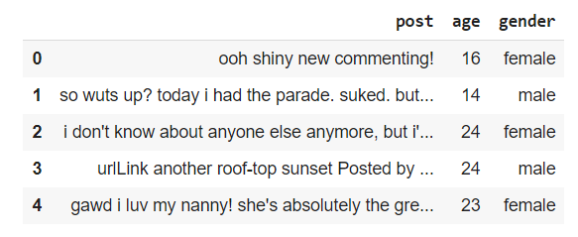
Data Description and Baseline
Dataset is acquired from Kaggle.com which consists 526813 training and 154475 test examples.
Attributes – post, age, gender
We converted the 3 discrete age groups into
Minor - <17
Mature >33
Adult

Slide 4
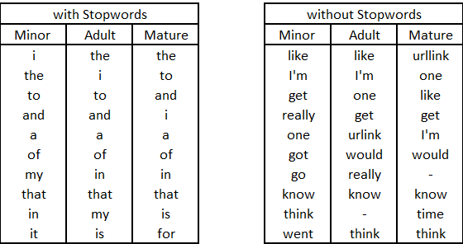
Text Pre - Processing
Retained stop words
Lower case characters
Removed Punctuations
Removed words whose character length is less than 3 and greater than 15.
Demonstration of text pre-processing
Raw text - “I live in 49 S Maxwell Street, Maxwell's building”
Processed text - “live maxwell street maxwell building”

Slide 5
Feature Vectorization – Tokenizing, Counting, Normalization
Feature Vectorization
CountVectorizer
Embedding To capture the meaning of words
GloVe .
Doc2Vec
converts a collection of text documents to a matrix of token counts which produces a sparse representation of the counts.
Tf-idf
Intended to reflect how important a word is to a document in a collection or corpus - is computed as: tf(t) x idf (t) = tf(t) x log (1+n / 1 + df(t)) + 1
We used Pre-trained version - by averaging word vectors of a document.
Trained with genism
- PV–DM model

Slide 6

Models
Naïve Bayes
Support Vector machine
Random Forest
Logistic Regression
Naïve Bayes classifier is the simplest instance of a probabilistic classifier.
The output Pr(C|d) of a probabilistic classifier is the probability that a document d belongs to a class C.
SVMs can process data in high dimensional space with the selection of right kernel mapping function.
We used this to test one-vs-all to determine if certain blogs can be classified into the correct labels.
As Language is diverse, there is a chance of high variance and to reduce the effects of high variance we used RFC
Due to the possibility of language bias within the age groups, we used logistic regression to compare against high bias setting.

Slide 7

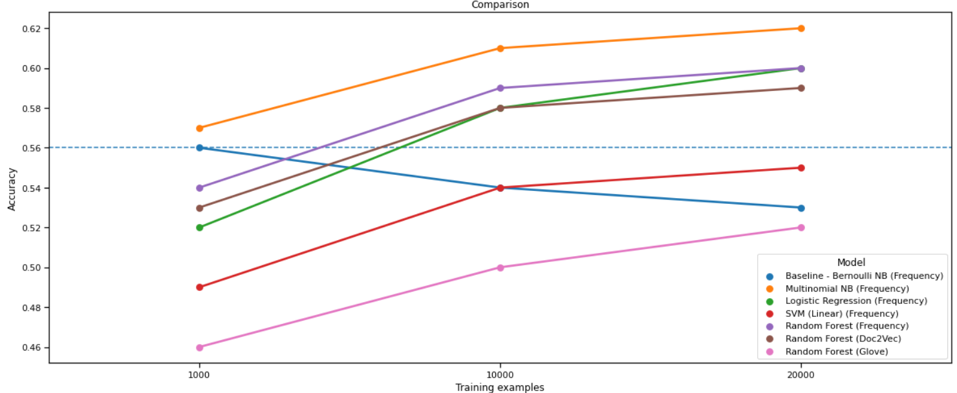
Results
Baseline Model: Bernoulli Naive Bayes
Observations:
Baseline performance is deteriorating.
Count vectorizer with Multinomial Naïve Bayes outperformed other models.
With increasing training examples models start to perform better.
RF, RF(Doc2Vec) and LR’s accuracies are increasing significantly.
With more examples, SVM outperforms baseline.
SVM and RF (GloVe) would further improve with more training examples.
Baseline

Slide 8
Conclusion and Future Scope
Demonstrated feature selection and impacts
Naive Bayes is outperforming other statistical models and feature vectorizations.
The performance is directly affected by the quality and quantity of data.
Feature vectorizing phase is important to make the data being more precise (to achieve a better classification result)
It is then important to discover and interpret which features are useful and critical.
Advanced predictive models like CNN, RNN, LSTM would improve the performance.

Slide 9


Questions???

